Slide 1
Qualifying Exam
Jiawen Liu
Advised by: Marco Gaboardi

Slide 2
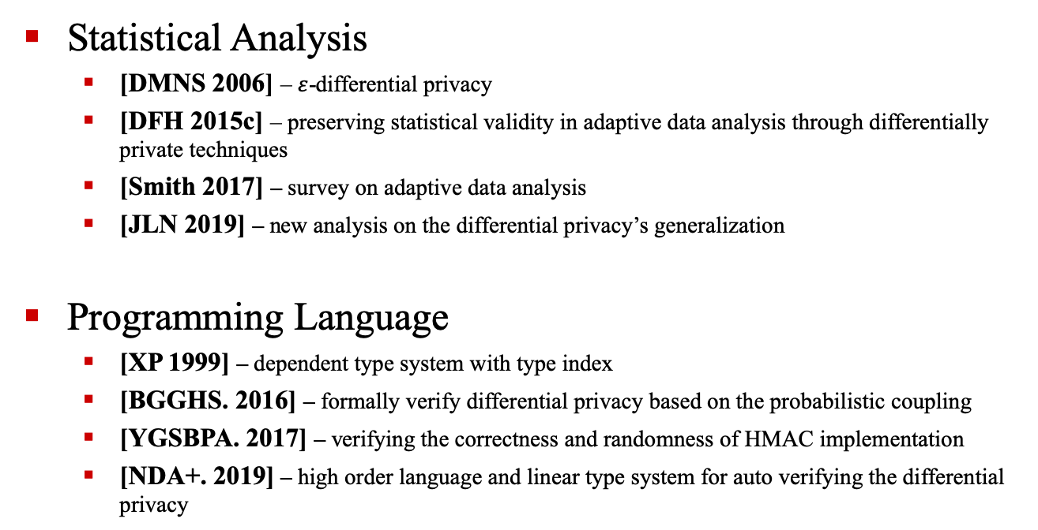
Short Summary – 8 paper
Statistical Analysis
[DMNS 2006] – $ε$-differential privacy
[DFH 2015c] – preserving statistical validity in adaptive data analysis through differentially private techniques
[Smith 2017] – survey on adaptive data analysis
[JLN 2019] – new analysis on the differential privacy’s generalization
Programming Language
[XP 1999] – dependent type system with type index
[BGGHS. 2016] – formally verify differential privacy based on the probabilistic coupling
[YGSBPA. 2017] – verifying the correctness and randomness of HMAC implementation
[NDA+. 2019] – high order language and linear type system for auto verifying the differential privacy

Slide 3
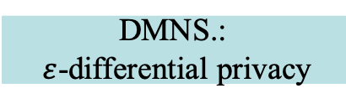
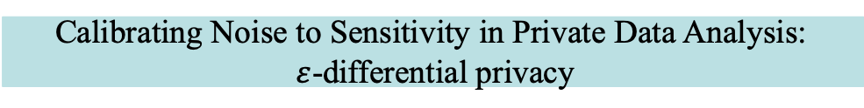
Relations & Importance
2019
2017
2016
2015
2013
2010
2006
1999
JLNRSS.
NDA+.
Adam Smith.
YGSBPA.
BNSSSU.
GGM+
BGGHS.
DFHPRR. [2015a]
[2015b]
DFHPRR. [15c]
GHHNP.: dFuzz
Guaranteeing validity in adaptive data analysis
Reed and Pierce: Fuzz
Formally verifying differential privacy
DMNS.:
$ε$-differential privacy
Calibrating Noise to Sensitivity in Private Data Analysis:
$ε$-differential privacy
Xi and Pfenning

Slide 4
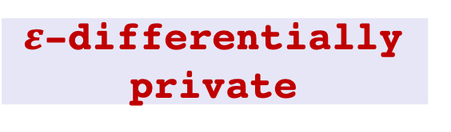
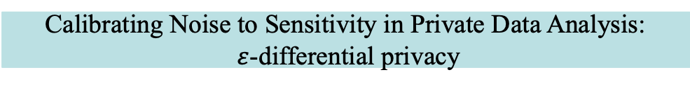
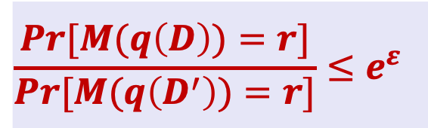
Calibrating Noise to Sensitivity in Private Data Analysis:
$ε$-differential privacy
Privacy loss
$$\frac{Pr[M(q\left(D\right))=r]}{Pr[M(q\left(D^{′}\right))=r]}≤e^{ε}$$
Perturbed result r
M Add noise calibrated to the query q’s sensitivity
Mechanism M is
$ε$-differentially private
True result t
query q
Data Base D

Slide 5
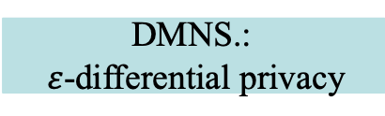
Guaranteeing validity in adaptive data analysis
2019
2017
2016
2015
2013
2010
2006
1999
JLNRSS.
Adam Smith.
BNSSSU.
DFHPRR. [2015a, b]
Preserving Statistical Validity in Adaptive Data Analysis
DFHPRR. [15c]
First Relevant Direction: Extend dp into validity Guaranteeing in adaptive data analysis
DMNS.:
$ε$-differential privacy

Slide 6




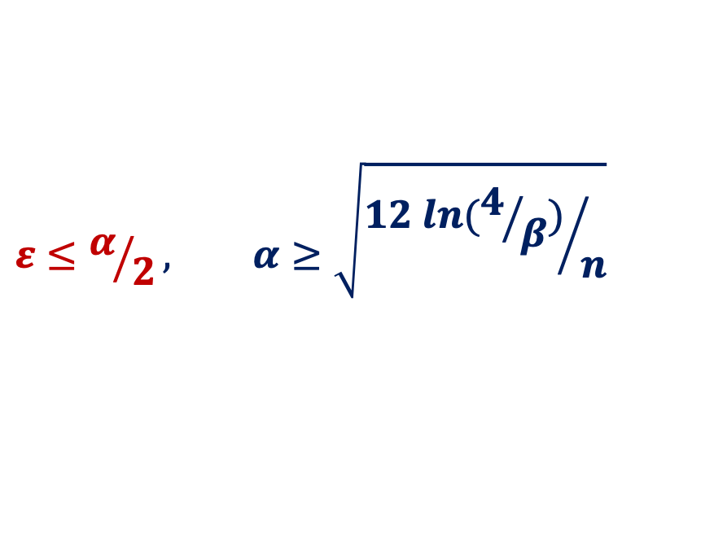

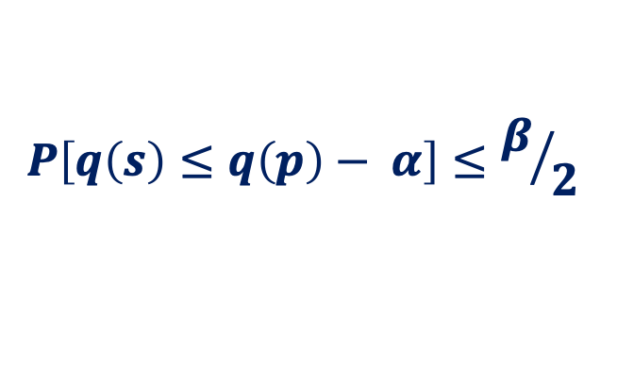
Preserving Statistical Validity in Adaptive Data Analysis
Transfer Theorem – query $q$ is $ε−$differentially private
Sample
Distribution
$$S$$
$$P$$
$$q(S)$$
$$\sim$$
$$q(P)$$
$$P\left[q\left(s\right)≤q\left(p\right)− α\right]≤β/2$$
$$ε≤α/2, α≥\sqrt{{12 ln(4/β)}/n}$$

Slide 7
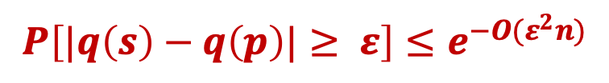
Guaranteeing validity in adaptive data analysis
2019
2017
2016
2015
2013
2010
2006
1999
JLNRSS.
Adam Smith.
$$P\left[|q\left(s\right)−q\left(p\right)|≥ ε\right]≤e^{−O(ε^{2}n)}$$
BNSSSU.
Holdout Reuse
DFHPRR. [2015a, b]
DFHPRR. [15c]
DMNS.:
$ε$-differential privacy

Slide 8
Guaranteeing validity in adaptive data analysis
2019
2017
2016
2015
2013
2010
2006
1999
JLNRSS.
Information Privacy and Stability in Adaptive Data Analysis
Adam Smith.
BNSSSU.
DFHPRR. [2015a, b]
DFHPRR. [15c]
DMNS.:
$ε$-differential privacy

Slide 9
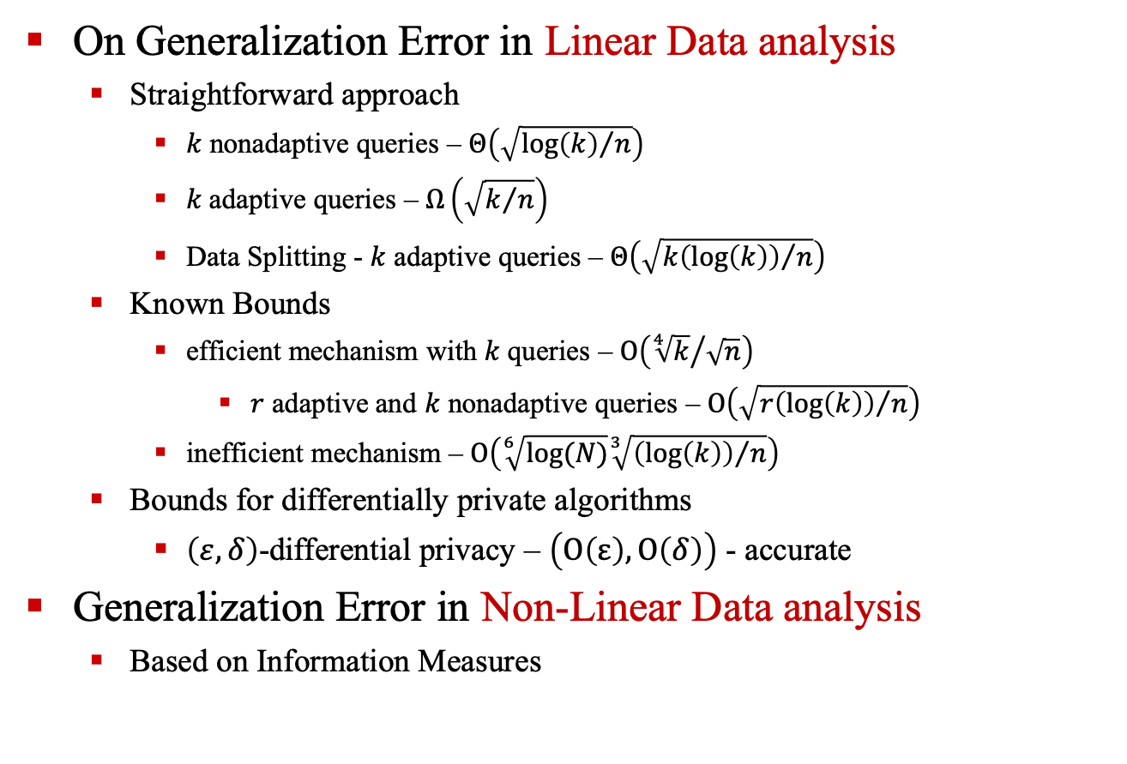
Information Privacy and Stability in Adaptive Data Analysis
On Generalization Error in Linear Data analysis
Straightforward approach
$k$ nonadaptive queries – $Θ\left(\sqrt{{\log\left(k\right)}/n}\right)$
$k$ adaptive queries – $Ω\left(\sqrt{k/n}\right)$
Data Splitting - $k$ adaptive queries – $Θ\left(\sqrt{{k\left(\log\left(k\right)\right)}/n}\right)$
Known Bounds
efficient mechanism with $k$ queries – $Ο\left({\sqrt[4]{k}}/{\sqrt{n}}\right)$
$r$ adaptive and $k$ nonadaptive queries – $Ο\left(\sqrt{{r\left(\log\left(k\right)\right)}/n}\right)$
inefficient mechanism – $Ο\left(\sqrt[6]{log⁡(N)}\sqrt[3]{{\left(\log\left(k\right)\right)}/n}\right)$
Bounds for differentially private algorithms
$\left(ε, δ\right)$-differential privacy – $\left(Ο\left(ε\right),Ο\left(δ\right)\right)$ - accurate
Generalization Error in Non-Linear Data analysis
Based on Information Measures

Slide 10
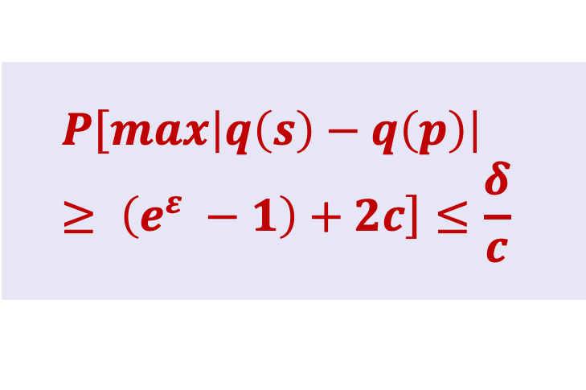
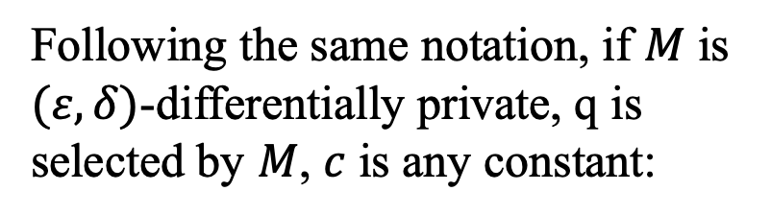
Guaranteeing validity in adaptive data analysis
2019
2017
2016
2015
2013
2010
2006
1999
JLNRSS.
Following the same notation, if $M$ is $(ε, δ)$-differentially private, q is selected by $M$, $c$ is any constant:
Adam Smith.
BNSSSU.
DFHPRR. [2015a, b]
DFHPRR. [15c]
$$P\left[max\left|q\left(s\right)−q\left(p\right)\right|≥ \left(e^{ε} −1\right)+2c\right]≤\frac{δ}{c}$$
DMNS.:
$ε$-differential privacy

Slide 11
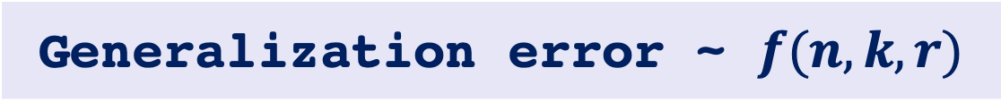
Consideration
Generalization error ~ $f(n, k, r)$
Formal verification
Theory proofs
?
Algorithm
implementation
program

Slide 12
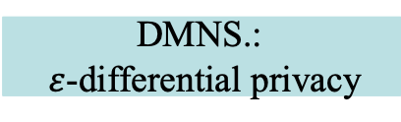

Formal Verification of differential privacy
2019
2017
2016
2015
2013
2010
2006
1999
NDA+.
Enriched type system with dependent types:
Index objects from Constraint Domains: $Index sort: γ$ $Index objects:a\left| ()\right| (i, j)|…$
Universal Dependent Types $τ$: $Πa: γ. τ$
Existential Dependent Types $τ$ $Σa: γ. τ$
YGSBPA.
GGM+
BGGHS.
GHHNP.: dFuzz
Reed and Pierce: Fuzz
DMNS.:
$ε$-differential privacy
Xi and Pfenning

Slide 13
Formal Verification of differential privacy
2019
2017
+2016
2015
2013
2010
2006
1999
Linear Dependent Type System
NDA+.
YGSBPA.
+
GGM+
BGGHS.
Probability monad
Track the sensitivity and automatically guarantee the differential privacy
GHHNP.: dFuzz
Reed and Pierce: Fuzz
DMNS.:
$ε$-differential privacy
Xi and Pfenning

Slide 14
Formal Verification of differential privacy
2019
2017
2016
2015
2013
2010
2006
1999
NDA+.
YGSBPA.
GGM+
BGGHS.
A probabilistic programming system for formally verifying the differentially private Bayesian inference
GHHNP.: dFuzz
Reed and Pierce: Fuzz
DMNS.:
$ε$-differential privacy
Xi and Pfenning

Slide 15
Formal Verification of differential privacy
2019
2017
2016
2015
2013
2010
2006
1999
NDA+.
YGSBPA.
GGM+
BGGHS.
A relational programming logic combining with probabilistic couplings and liftings.
GHHNP.: dFuzz
Reed and Pierce: Fuzz
DMNS.:
$ε$-differential privacy
Xi and Pfenning

Slide 16
Formal Verification of differential privacy
2019
2017
2016
2015
2013
2010
2006
1999
NDA+.
YGSBPA.
GGM+
BGGHS.
1. Formalizing the implementation of HMAC
2. Formally verified the correctness and randomness of HMAC in Coq.
GHHNP.: dFuzz
Reed and Pierce: Fuzz
DMNS.:
$ε$-differential privacy
Xi and Pfenning

Slide 17
Formal Verification of differential privacy
2019
2017
2016
2015
2013
2010
2006
1999
Higher-order language
NDA+.
+
YGSBPA.
Linear type system
GGM+
BGGHS.
Automatically verifying differential privacy of general-purpose higher-order programs
GHHNP.: dFuzz
Reed and Pierce: Fuzz
DMNS.:
$ε$-differential privacy
Xi and Pfenning

Slide 18

Consideration
$ε/(ε, δ)$-differentially private
?
Formal verification
Formally verifying Snapping Mechanism[1]
Realistic program with floating point error
Ideal program
implementation
Differentially Private Algorithms
[1] Mironov, Ilya, On Significance of the Least Significant Bits For Differential Privacy, CCS 2012

Slide 19

Possible Research Directions
Formally verifying the realistic implementation of dp-algorithms: snapping mechanism
formal verification of the program’s statistical validity.
Guaranteeing validity in adaptive data analysis
Formally verifying differential privacy
2019
2017
2016
2015
2013
2010
2006
1999
JLNRSS.
NDA+.
Adam Smith.
YGSBPA.
BNSSSU.
GGM+
BGGHS.
DFHPRR. [2015a]
[2015b]
DFHPRR. [15c]
GHHNP.: dFuzz
Reed and Pierce: Fuzz
DMNS.: $ε$-differential privacy
Xi and Pfenning

Slide 20
Formal verification of the program’s statistical validity.
Research Goals. [DFHPRR.’15, Adam Smith’17, JLNRSS.’19…]
Guaranteeing the generalization error for implementations of adaptive data analysis.
Helping programmer to optimize their programs to have better generalizations.
Challenges.
Figuring out the program’s adaptive query numbers, i.e. the program’s adaptivity.
Methodologies. [Xi and Pfenning ‘99 , NDA+’19, …]
Designing a dependent type system and language that

Slide 21
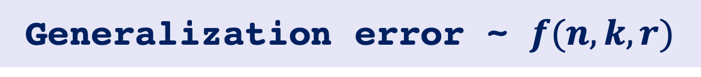
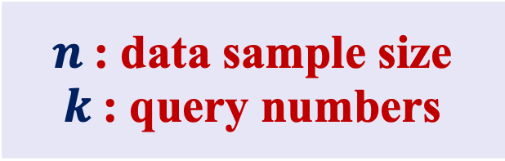
Research Goals &. Challenge
Generalization error ~ $f(n, k, r)$
Easily Track
Challenge
$n$: data sample size
$k$: query numbers
Adaptive query numbers

Slide 22






Research Goals &. Challenge
input
$${query}_{1} (X)$$
$$X$$
$${query}_{2}( ,X)$$
adaptive query numbers
$${query}_{3}( ,X)$$
…
$${query}_{k}( ,X)$$
output
$$R$$

Slide 23
Methodologies
prog
type system
adaptivity
depth
input
output

Slide 24
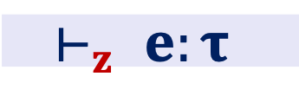
Methodologies – Language Design
Refinement Types [Xi and Pfenning 1999]
Helping programmer to optimize their programs to have better generalizations.
Expressions.[LG ’11…]
Figuring out the program’s adaptive query numbers, i.e. the program’s adaptivity.
Typing Judgement. [LG ’11…]
approximates an upper bound on adaptive query numbers
$$⊢_{z} e:τ$$
upper bound of adaptive query numbers
Ugo Dal Lago and Marco Gaboardi, Linear Dependent Types and Relative Completeness, LICS, 2011

Slide 25
Possible Research Directions
Formally verifying the realistic implementation of dp-algorithms: snapping mechanism
formal verification of the program’s statistical validity.
Guaranteeing validity in adaptive data analysis
Formally verifying differential privacy
2019
2017
2016
2015
2013
2010
2006
1999
JLNRSS.
NDA+.
Adam Smith.
YGSBPA.
BNSSSU.
GGM+
BGGHS.
DFHPRR. [2015a]
[2015b]
DFHPRR. [15c]
GHHNP.: dFuzz
Reed and Pierce: Fuzz
DMNS.: $ε$-differential privacy
Xi and Pfenning

Slide 26
Formal verification of differential privacy (snapping mechanism)
Research Goals. [Ilya Mironov ’12…]
Verifying the actual privacy loss for the realistic implementations of differentially private algorithms
Challenges. [Ilya Mironov ’12…]
Keep track of the floating point error
Generate the actual privacy loss given the floating point error
Methodologies. [NDA+.’19, BGGHS.’16, YGSBPA.’17…]
Design verification system based on the logic of probabilistic coupling and proof techniques in Coq.
[1] Mironov, Ilya, On Significance of the Least Significant Bits For Differential Privacy, CCS 2012

Slide 27
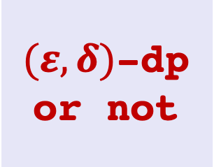
Methodologies
prog:
floating point implementation
input
Programming logic
output
$(ε, δ)$-dp or not

Slide 28
Thanks!

